Slide 1
GenAI Agent

Slide 2
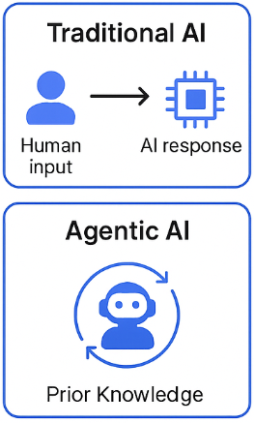
What Is Agentic AI?
Agentic AI refers to AI systems designed to function as autonomous agents that can:
👁️ Perceive their environment
🧩 Reason about tasks
🤖 Act independently to achieve goals
Key Difference from Traditional AI:
Unlike traditional models that require constant human input, Agentic AI makes dynamic decisions using:
📊 Data
🌐 Context
📚 Prior Knowledge

Slide 3
Key Features of Agentic AI
Autonomy: Operates without constant human oversight.
Goal-Orientation: Works towards achieving defined objectives.
Context-Awareness: Adapts to changes in the environment or task requirements.
Interactivity: Communicates with humans and other systems seamlessly.
Why Agentic AI Matters
The rise of Agentic AI is fueled by the demand for intelligent systems capable of handling complex, dynamic scenarios. Applications range from autonomous vehicles and intelligent customer service bots to industrial automation and real-time financial analysis.

Slide 4
Benefits of Agentic AI
Efficiency: Reduces the need for manual intervention, streamlining operations.
Scalability: Handles multiple tasks simultaneously across diverse domains.
Adaptability: Learns and adjusts to new conditions without requiring reprogramming.
Human-AI Collaboration: Acts as a co-pilot, enhancing decision-making rather than replacing humans entirely.

Slide 5
Challenges in Building Agentic AI
Despite its promise, Agentic AI comes with its own set of challenges:
Complexity: Designing agents capable of handling dynamic environments is inherently complex.
Ethical Concerns: Ensuring responsible behavior in autonomous systems is critical.
Scalability: Managing multiple agents while maintaining performance and accuracy.
Security: Preventing misuse or adversarial attacks on autonomous systems.

